Slide 1
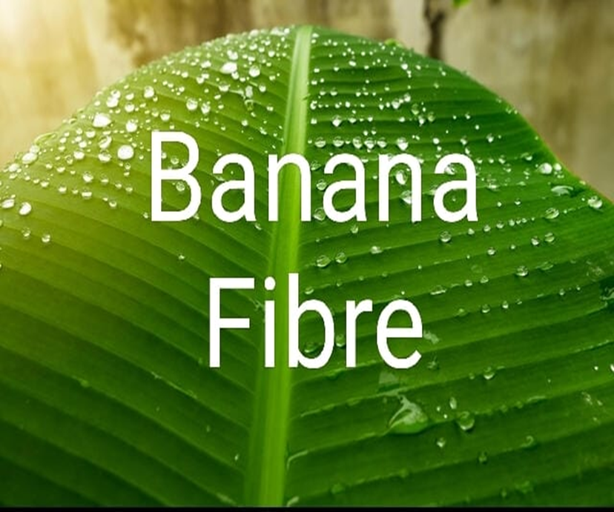
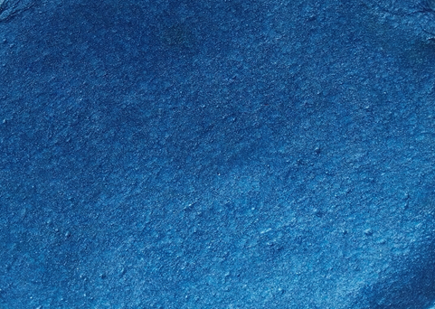
Process and Machine development for Banana Fibres Based Value-added Products Non- Woven Fabric and Crafts
PI: Mrs. UMA THERE, RCI,MGIRI
CO-PI: Mr.VIKAS CHOUDHARY, RCI,MGIRI
CO-PI: Mr.GANESH THERE, REI, MGIRI
Non-Woven Fabric

Slide 2
Banana plant cultivation in India
Name of the states | Banana Production per year | Contribution to the total banana production in the country
Andhra Pradesh | 5.83 million tonnes | 18%
Maharashtra | 4.62 million tonnes | 14%
Gujarat | 3.90 million tonnes | 12%
Tamil Nadu | 3.89 million tonnes | 12%
Karnataka | 3.71 million tonnes | 11.5%
Uttar Pradesh | 3.39 million tonnes | 10.50%
Bihar | 1.96 million tonnes | 6%
West Bengal | 1.14 million tonnes | 3.50%
Assam | 1.10 million tonnes | 3.41%
Chhattisgarh | 0.58 million tonnes | 1.80%

Slide 3
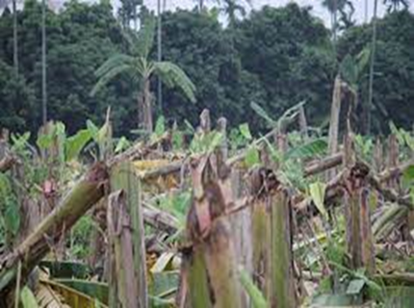
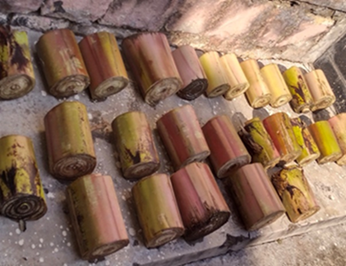
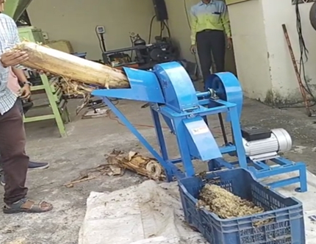
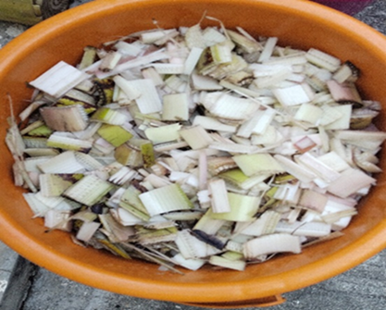
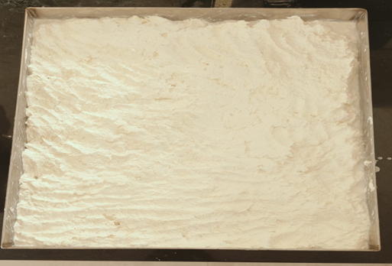
Sustainable Waste to Wealth Technology from Banana Plant Stem
Banana Fiber and Pulp Technology
Harvesting of banana plants.
Fiber Extraction (mechanical and chemical).
Pulp treatment for development of Non Woven Fabric and Crafts.

Slide 4
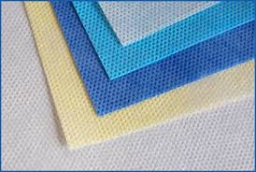

Non-Woven Fabric from banana Fibre
It is possible to make molten Non – Woven Fabric which are neither woven nor knitted.
Porous Material.
Reduces the usage of polypropylene(pp) based Non woven fabrics
In addition, nonwoven fabrics can be recycled after use.
Eco-Friendly.
Non-Woven Fabric
Non-Woven Fabric
Plastic based Non-woven fabric
Non-woven fabric made in MGIRI

Slide 5
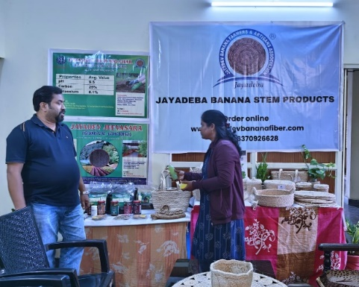
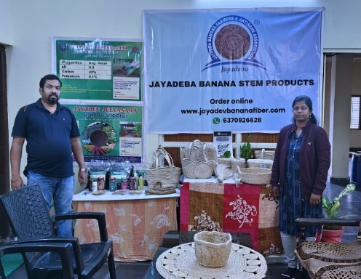
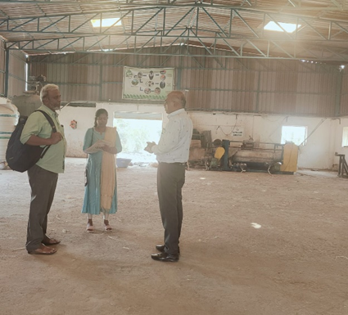
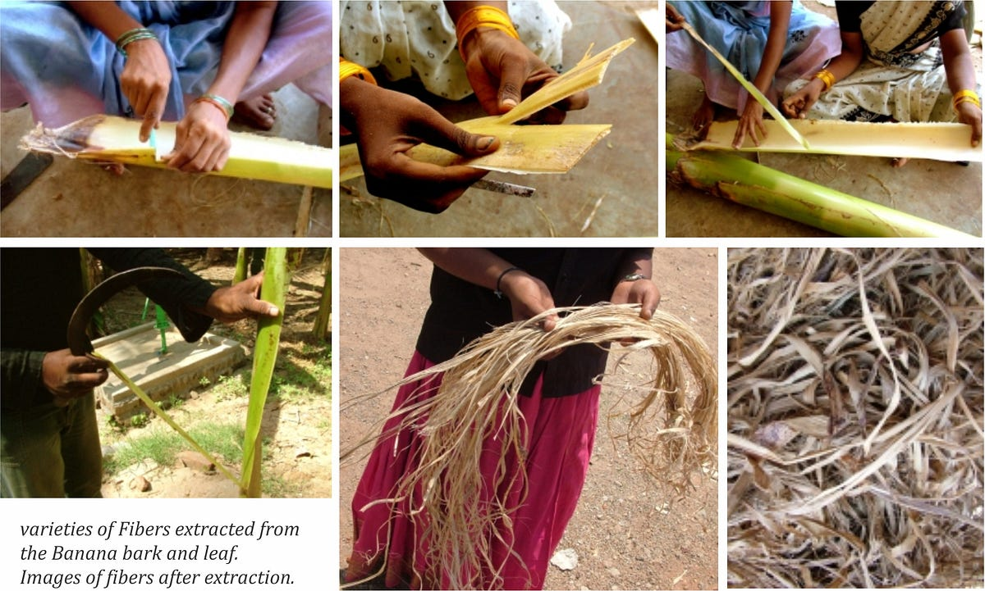
SFURTI Cluster Visit for Problem Identification
MGIRI team has visited the SFURTI Cluster Jayadev Banana Fiber Extraction Unit at Orissa, Bhubaneshwar and the PMEGP Fibre Extraction Unit, Mangalam Kalpataru Industries, Burhanpur.
The purpose of the visit is to identify the technical and financial challenges faced by the cluster.
The cluster has highlighted a concern about the low profit margins from their existing products. To address this issue, they are looking to expand and modernize various technologies within their production processes.
One key factor contributing to their decision to expand and modernize is the vast availability of raw materials, particularly the banana pseudo stem. The cluster recognizes the potential of their abundant resources and aims to capitalize on them for sustainable growth

Slide 6
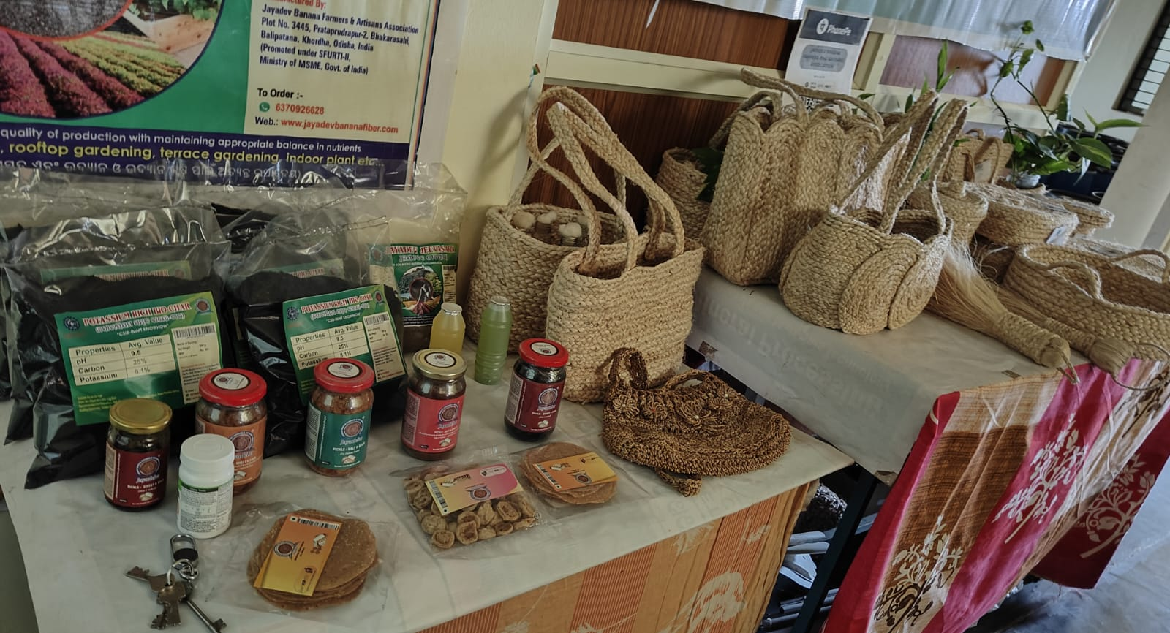
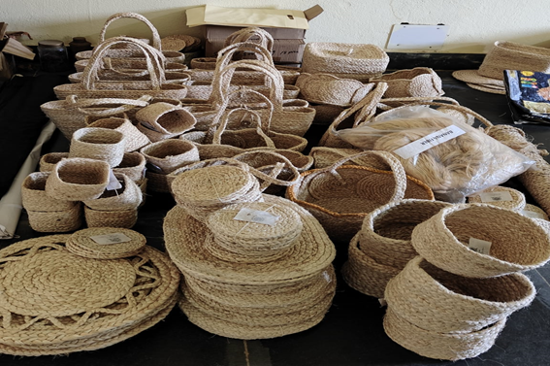
Problem Identification
Identified the products made from banana fibres through surveys conducted across the country including SFURTI CLUSTER, PMEGP units, banana research Institute, farmers
Table mats, baskets, brooms, purses yoga mats.
Sanitary napkins
Pickles
Health drinks
Bio Char

Slide 7
Justification for Consideration
Reduction of polypropylene(pp) based Non woven fabrics usage
environmental, economic, and social benefits
Non-woven fabric made from banana fiber reduces environmental pollution.
synthetic polymers may release harmful pollutants into the environment during manufacturing and disposal.
additional income streams for farmers and communities engaged in banana cultivation.
This can contribute to poverty alleviation and rural development, empowering local communities economically.

Slide 8
Name of Project | FY-2024-25 |  |  |  | FY-2026-27
Process and Machine development for Value-added Products from Banana Fibre – Non-Woven Fabric and Fibre Crafts. | Q1 | Q2 | Q3 | Q4 |  | Q1 | Q2 | Q3 | Q4
 | A
 |  |  | B
 |  |  |  |  |  | C
 |  |  |  |  |  |  |  | D
Budget, Rs in lakhs | 7.65 lakhs |  |  |  |  | 7.35 lakhs
A | Field Visit to identify the problems and present status of raw material utilization and availability. Collection of Banana stems from farmers and Procurement of raw materials after the field study. Designing the suitable process to convert the Banana stem into Fibre. procurement of basic machineries and supporting machineries. Procurement of spare parts and accessories.
B | Optimization of Process and Method. Evaluation and Standardization. Fabrication of machineries and purchasing of supporting machineries.
C | Evaluation and validation of process and machineries.
D | Dissemination, Demonstration, training, workshops and Field Trials. Analysing and improving the technology based on the feedback received after field trials. Preparation of final report on the technology. Pilot project proposal for next level.

Slide 9
Applications of non woven fabrics
Packaging materials
Sanitary Napkins
Diapers and Wet Wipes
Disposables Masks and Caps
paper soaps
Possibility study will be carried out for textile fabric as well.

Slide 10
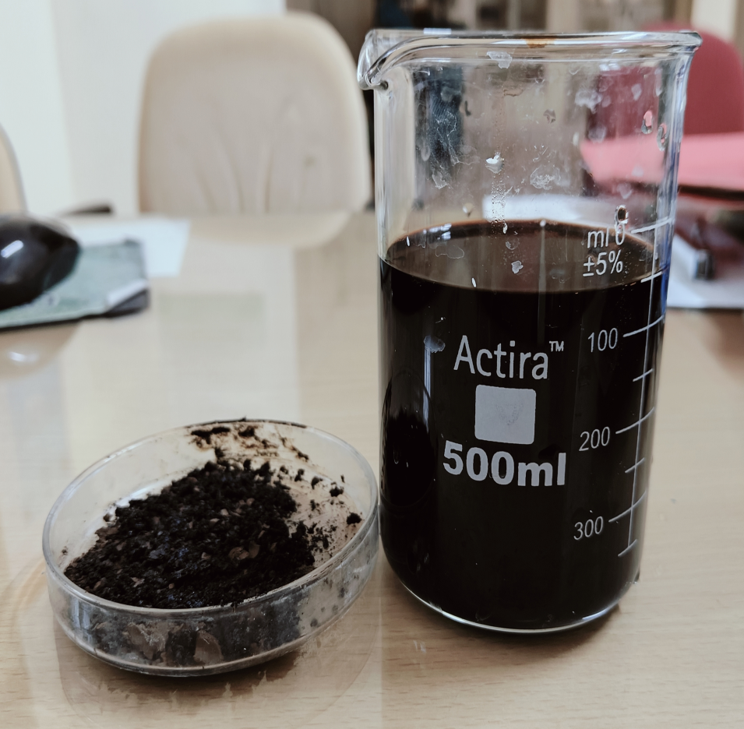
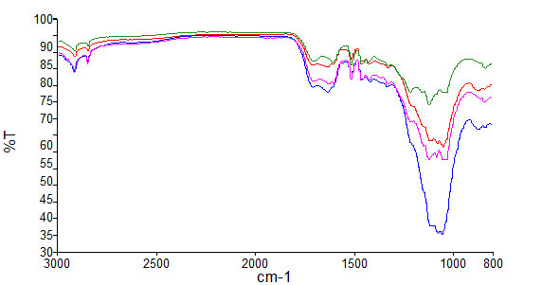

Separation of Lignin from byproduct of Banana Fibre Extraction (Black Liquor)
6-10 % of the Lignin is separated from the by-product generated in Banana Fibre Extraction process. The physiochemical Properties of separated lignin are under process.
Expected products to be developed from separated lignin – Coatings and adHESIVES
Water Proof Coatings
Concentration of Kraft Process | Dried stem sample | Fibre | Lignin
8% | 100 gm | 37.4 gm | 6 gm
10% | 100 gm | 37.5 gm | 10 gm
13 % | 100 gm | 37.9 gm | 4 gm

Slide 11
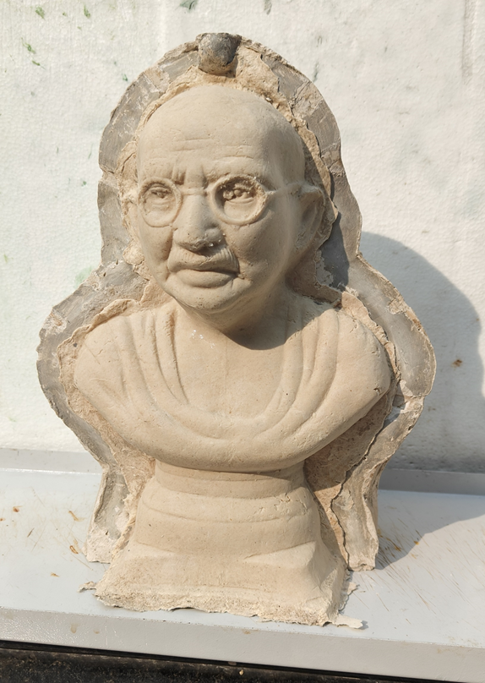
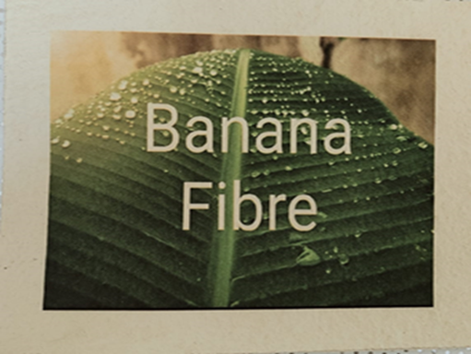
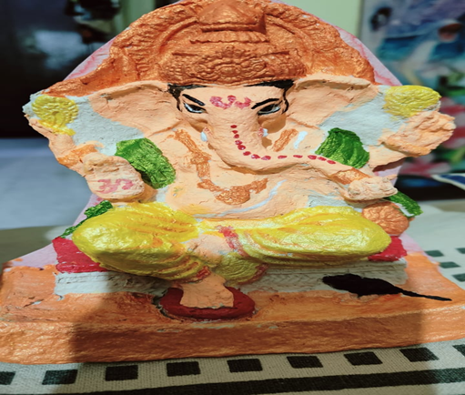
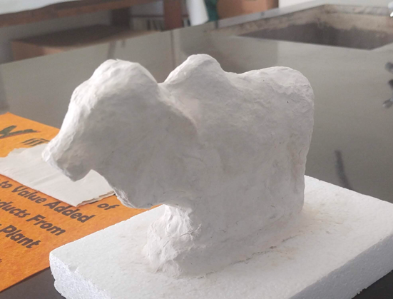
Fibre Crafts
The project empowers artisans to create unique, eco-friendly products that can potentially access niche markets by Providing them training workshops or skill development programs to artisans in rural areas on how to work with banana fiber.

Slide 12
Expected outcome of the Project
Process and Machine development of Non- Woven Fabrics and Fibre crafts.
Value addition from the banana waste from these will strengthen the livelihood and additional income to the farmers and banana processing units.
This will support in making new business models in the rural sector on banana value addition.

Slide 13
Project Budget
Approximate Project Cost: Rs.15.00 lakhs
SN | Particulars | Expenditure for I year in Lakhs) | Expenditure for II year in Lakhs)
1. | Non-recurring | 1.60 | 1.35
2. | Recurring | 5.16 | 5.16
 | Total | 6.76 | 6.51
 | Institutional Overhead and IRG (@13%) | 0.89 | 0.84
 | Total | 7.65 | 7.35

